Slide 1
College Placement Using Machine Learning
By: Kutlukkhan Alikhanov

Slide 2
College Placement
College placement is when students near the end of their college education land a job that is provided through a partnership between a company and the college.
The goal of the model is to predict whether a student gets placed.

Slide 3
Audience
The college and/or the company.
Notes:
Consider the end.

Slide 4
Goal
Cost the college/company as little as possible.
1
Streamline the placement process.
2
Pick the correct candidates for placement.
3

Slide 5
Data on Engineering Students
Age
Gender
Cumulative GPA
Internships
Hostel Status
Failed Class History
Stream
Placement

Slide 6
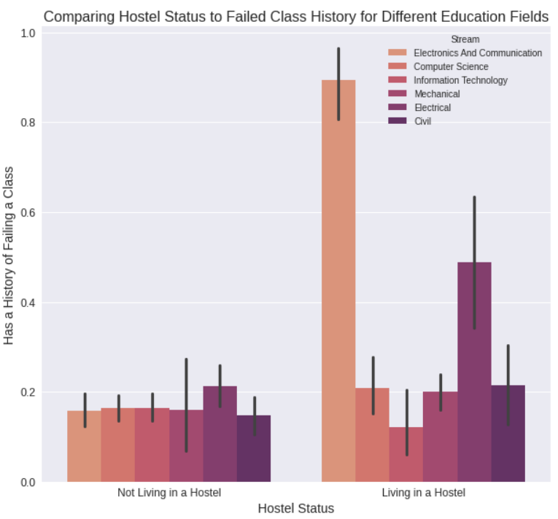
Hostel Status Comparison
There is a positive trend for those living in a hostel in the Electronics and Communication field as well as the Electrical field.
Interestingly the opposite is true for the Information Technology field.

Slide 7
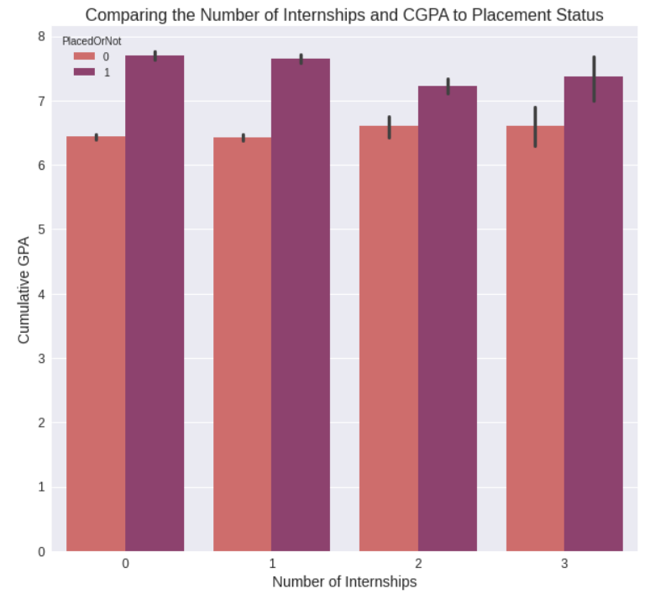
Cumulative GPA Comparison
We can see a difference in average CGPA for those placed and not.
There is an interesting trend as the number of internships grows.

Slide 8
Strengths and Weaknesses
This is not a general model.
Does not consider the “success” of placed students.
High success rate.
Minimizing false positives.
We do not want to recommend students that will not get placed as it will waste time, money and may affect the relationship between the college and the company.
False negatives.
The only downside to false negatives is opportunity.

Slide 9
Final Recommendations
I would recommend using the model to help speed up the placement process.
Would most likely work best in conjunction with the placement process.
If it is possible to provide data on how good placed students do that would help the model.
Do not try to use the model for students at other colleges.

Slide 10

Question Time

